Slide 1


Relationship Data Model

Slide 2


Relationship Data Model
What is Relationship Data Model ?

Slide 3
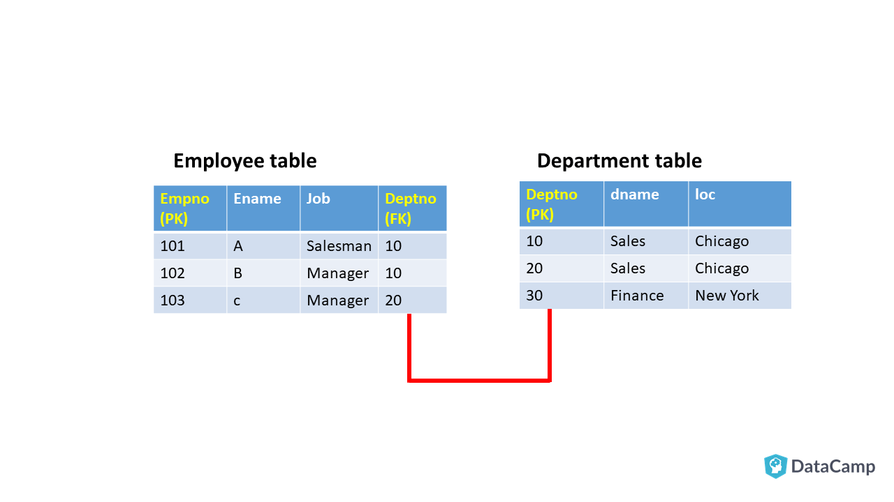
Relationship Data Model
Employee Table
Department Table

Slide 4
Relationship Data Model
The relationship data model focuses on two things:
Tables.
Relationships.
Employee Table
Department Table

Slide 5
THANK YOU

